Slide 1
DLT: Conditioned layout generation with Joint Discrete-Continuous Diffusion Layout Transformer ICCV 2023
Dohyun Kim
a12s12@korea.ac.kr
Multimodal Interactive Intelligence Laboratory (MIIL)

Slide 2
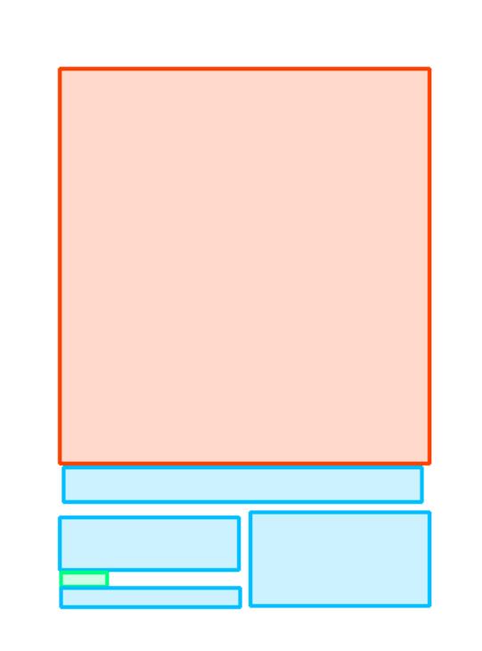
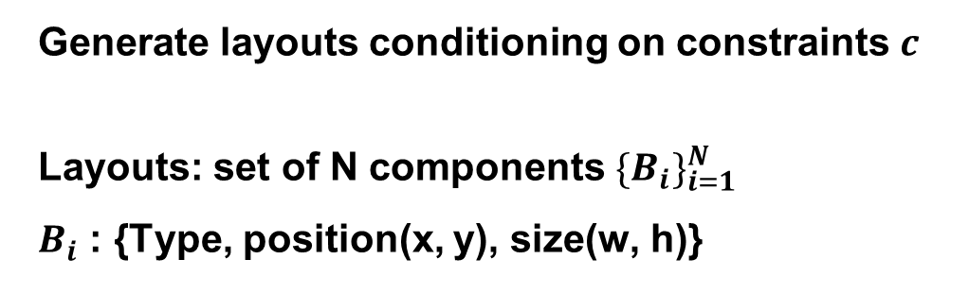
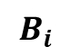
Goal
Generate layouts conditioning on constraints $c$
Layouts: set of N components ${\{B_{i}\}}_{i=1}^{N}$
$B_{i}$ : {Type, position(x, y), size(w, h)}
True or Unknown for each attributes (type, position, size)
$$B_{i}$$
Type
image
Text
Text
x: 24
x: 50
x: 94
Rendering
Position
y: 32
y: 76
y: 14
w: 102
w: 36
w: 78
Size
H: 53
H: 20
H: 30

Slide 3
Method
Autoregressive Transformer based models
- one element only depend on the generated part of the layout
→ hard to consider Global context
Non-autoregressive models(GAN, VAE) to consider global context
- not achieve significantly better performance with single pass
Diffusion model can consider global context and achieve better performance
- takes the layout in the last step as global context

Slide 4
Method
Based on Diffusion model
Layout data : discrete(type) and continuous (position, size)
Joint Discrete-Continuous Diffusion
Position, Size
Type
Continuous diffusion models: DDPM
Discrete diffusion models: D3PM

Slide 5
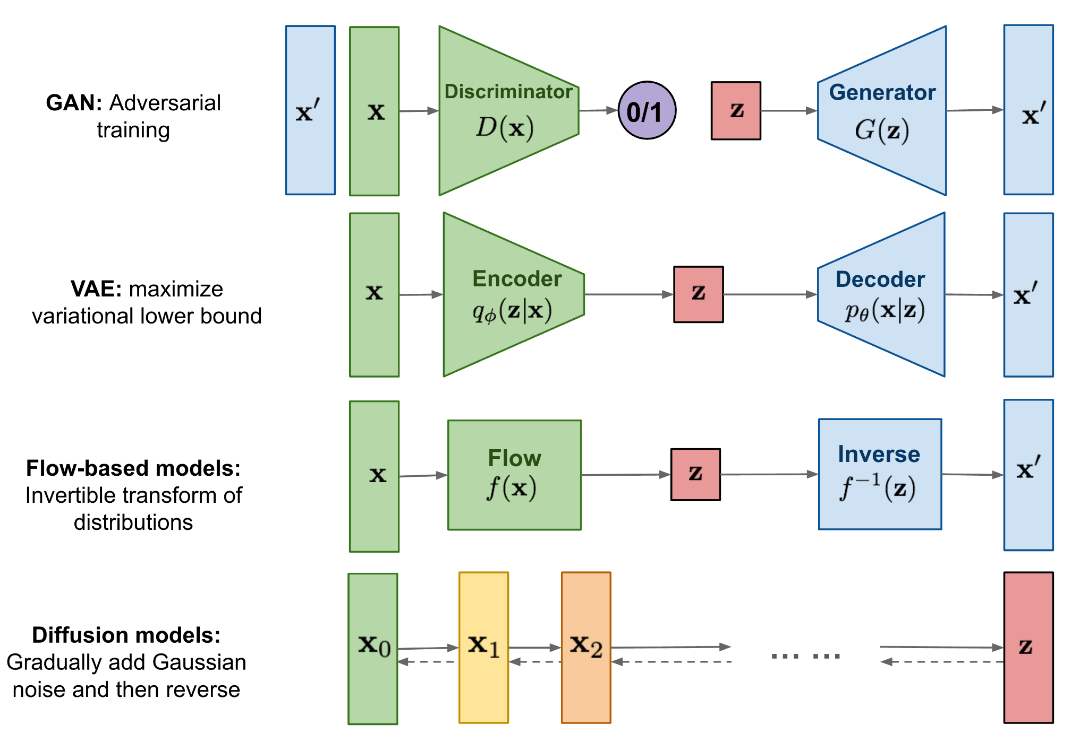
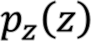

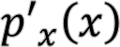
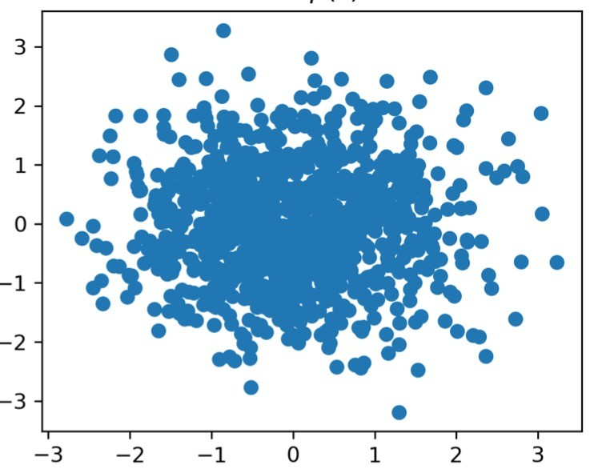
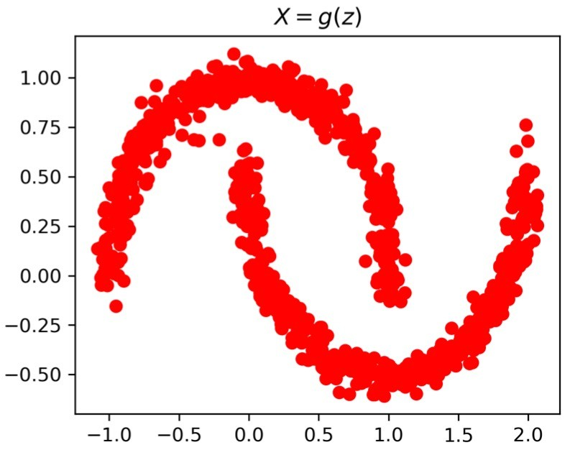
Generative Models
Generative model: Models that Generate similar data following the distribution of the training data by learning the training data
Generative Model
Latent space

Slide 6
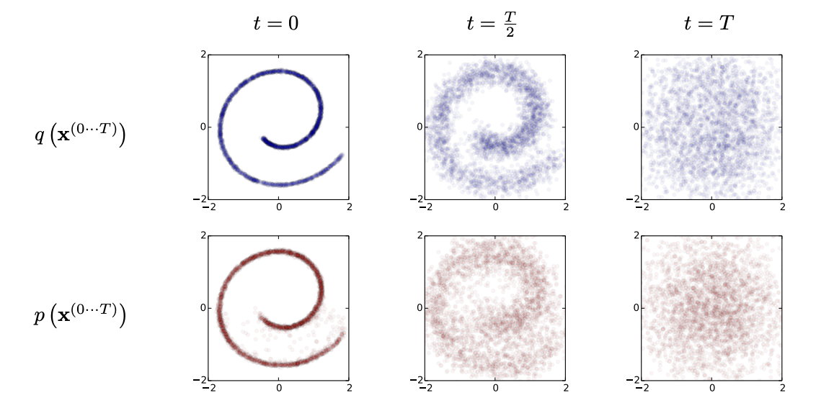
Diffusion Models
Suggested by “Deep Unsupervised Learning using Nonequilibrium Thermodynamics”(2015)
inspired by considerations from nonequilibrium thermodynamics
→ If the model learns the whole system which indicates moving to a uniform state,
could it also learn the process of reverting back to the original distribution?
In a very short time, The next position of the molecules is determined within the Gaussian Distribution

Slide 7
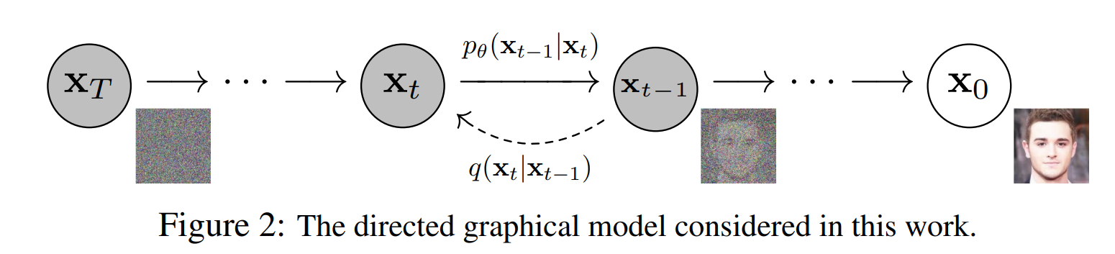
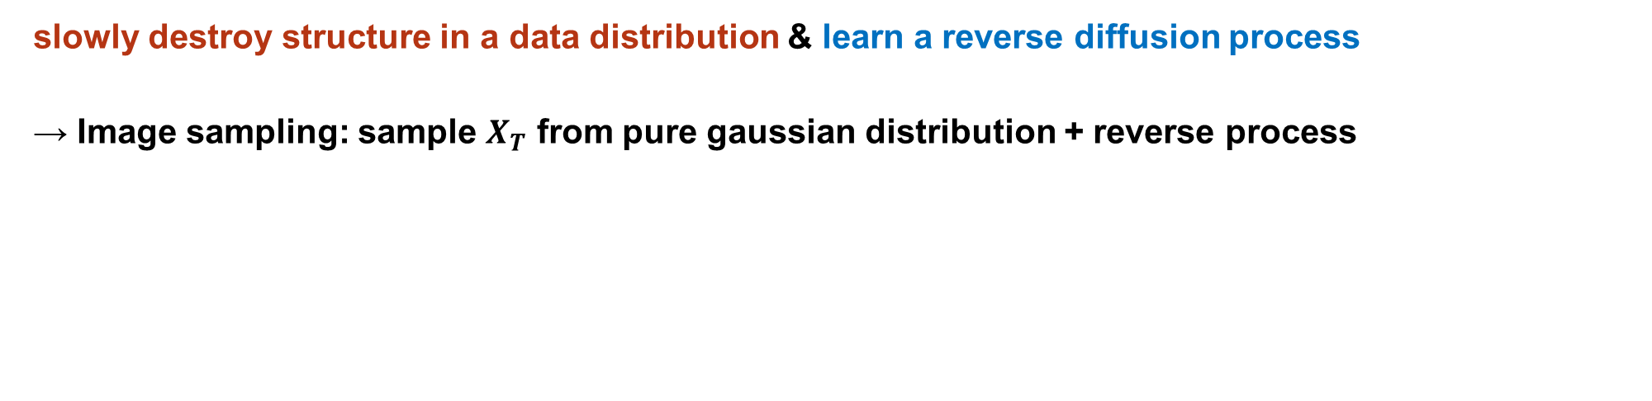
Diffusion Models
slowly destroy structure in a data distribution & learn a reverse diffusion process
→ Image sampling: sample $X_{T}$ from pure gaussian distribution + reverse process
T = 1000 (slowly destroy)
Reverse process $\sim q\left(X_{t−1} | X_{t}\right)$ but can’t find directly
Pure noise
Forward(Diffusion) process
DDPM “Denoising Diffusion Probabilistic Models” (NeurIPS, 2020):
simplify loss term → high quality generated images

Slide 8
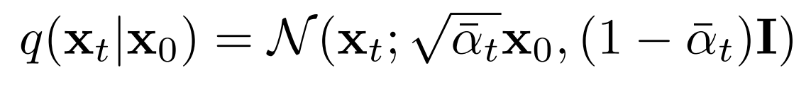
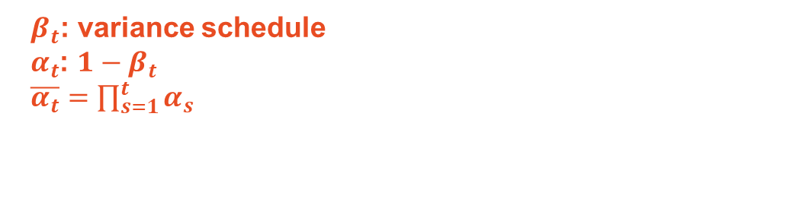
Forward(Diffusion) process
gradually adds Gaussian noise
→ pure Gaussian noise at timestep T
$β_{t}$: variance schedule
$α_{t}$: ${1−β}_{t}$
$\overline{α_{t}}=\prod_{s=1}^{t}{α_{s}}$
Reparameterization trick

Slide 9
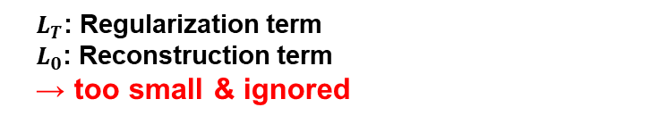
Reverse process
Maximize $logp_{θ}\left(X_{0}\right)$ but intractable
Find Variational upper bound on negative log likelihood
Using bayes rule, Markov chain and some tricks
$L_{T}$: Regularization term
$L_{0}$: Reconstruction term
→ too small & ignored
In VAE

Slide 10
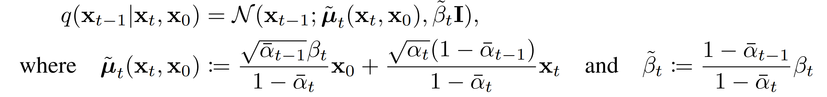
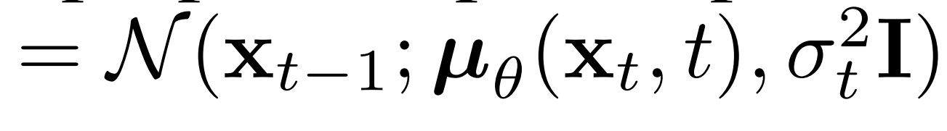
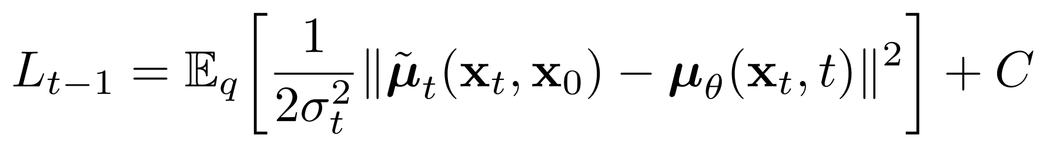
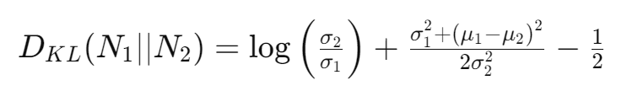
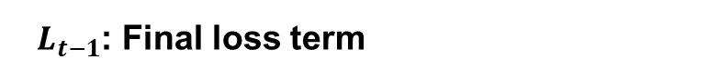

Reverse process
$L_{t−1}$: Final loss term
Untrained (fixed as constant → simplified)
Forward process posterior mean
Model output
Other KL divergence term
KL divergence ($μ$)

Slide 11
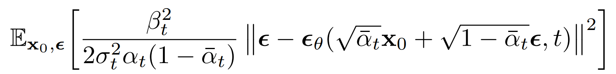
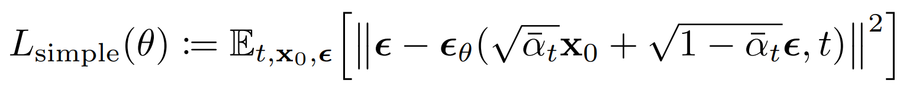
Reverse process
Simplify loss term → predict noise
denoising model
Reformulating the loss function to predict residuals! (It is possible to predict $X_{0}$ but worse quality)
Model can focus on more difficult denoising tasks at lager t terms

Slide 12
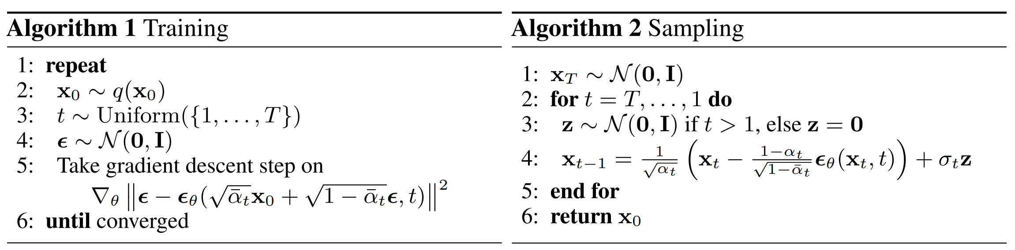
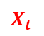
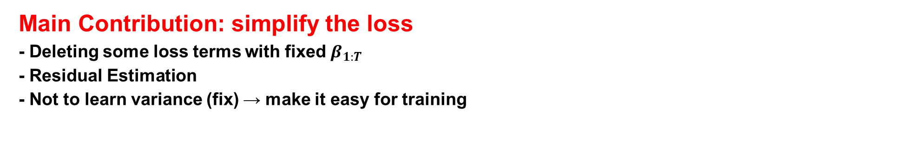
DDPM
Overall algorithm
$X_{t}$
Main Contribution: simplify the loss
- Deleting some loss terms with fixed $β_{1:T}$
- Residual Estimation
- Not to learn variance (fix) → make it easy for training

Slide 13
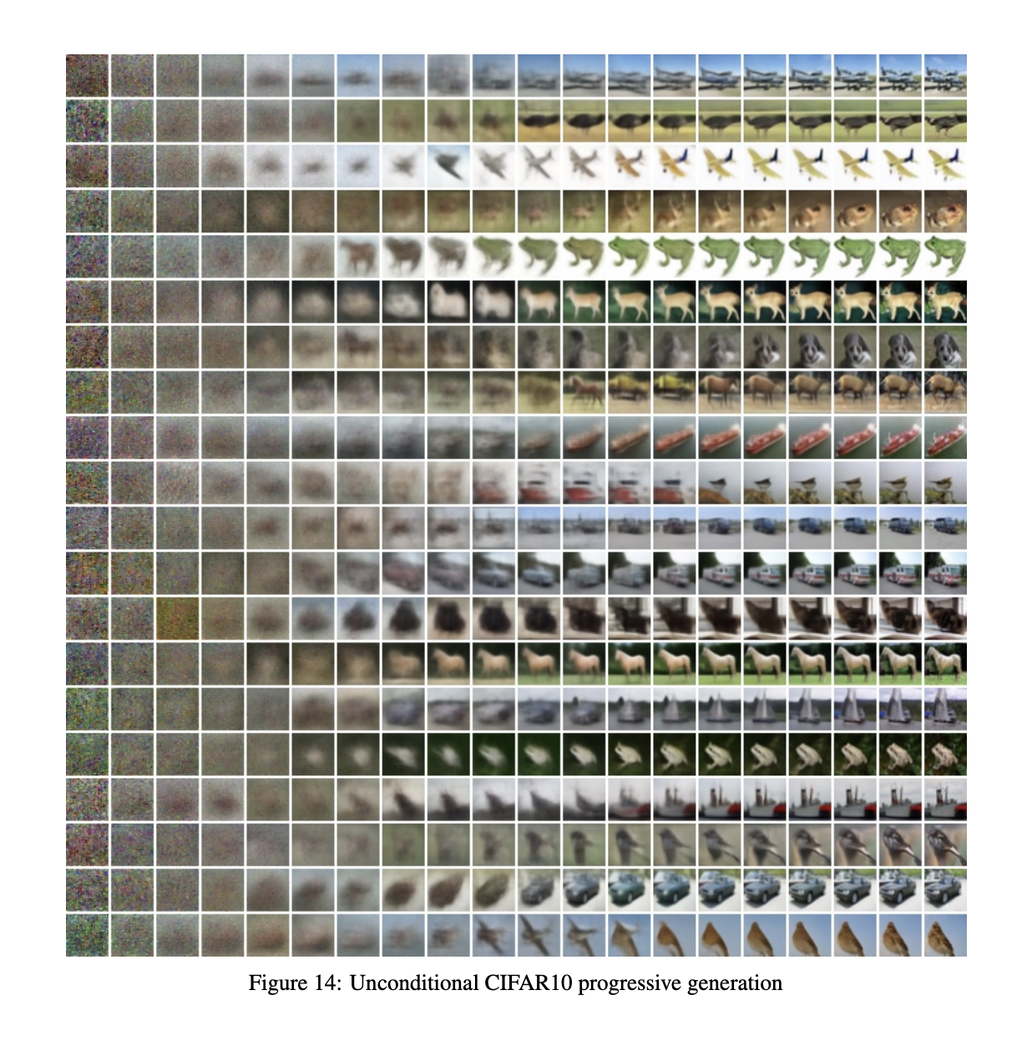
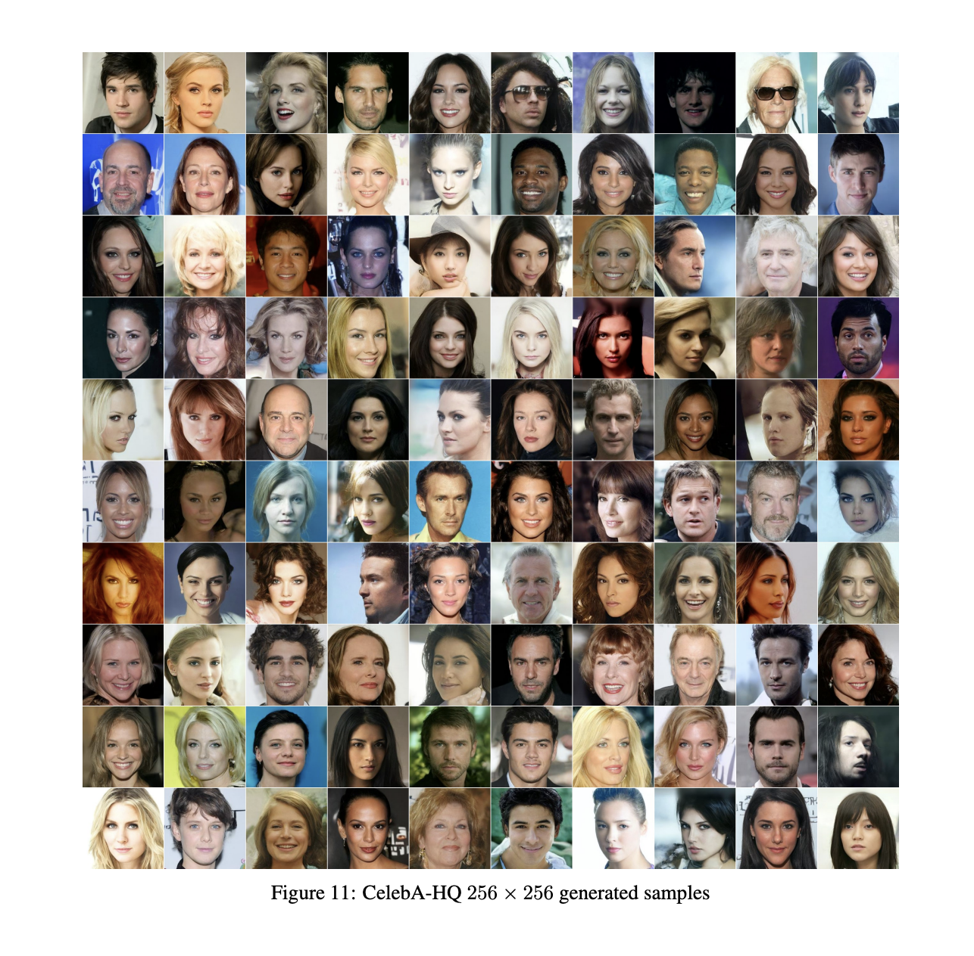
Result of DDPM

Slide 14
Evolution of diffusion models
“Deep Unsupervised Learning using Nonequilibrium Thermodynamics.”
“Denoising Diffusion Probabilistic Models.” (DDPM)
“Improved Denoising Diffusion Probabilistic Models.”(DDIM) → accelerate sampling
“Diffusion Models Beat GANs on Image Synthesis.” → high quality on conditional image generation using classifier guidance
“High-Resolution Image Synthesis with Latent Diffusion models”(LDM) → diffusion in latent space (VQ-VAE)
“Classifier-Free Diffusion Guidance” → improve conditional image generation
“Prompt-to-Prompt Image Editing with Cross-Attention Control → image editing
DALL-E 2
Imagen
SDXL
ControlNet
Sora

Slide 15
Why is diffusion powerful?
Gradually noising and denoising process
→ Stable training (compared with GAN)
- Robustness to Overfitting
- Flexible generators for various types of conditioning
- Scalability → large models → fine tuning or utilize for derived tasks
→ Interpretable Latent Space (1000 steps)
- generate diverse samples (randomness between steps)

Slide 16
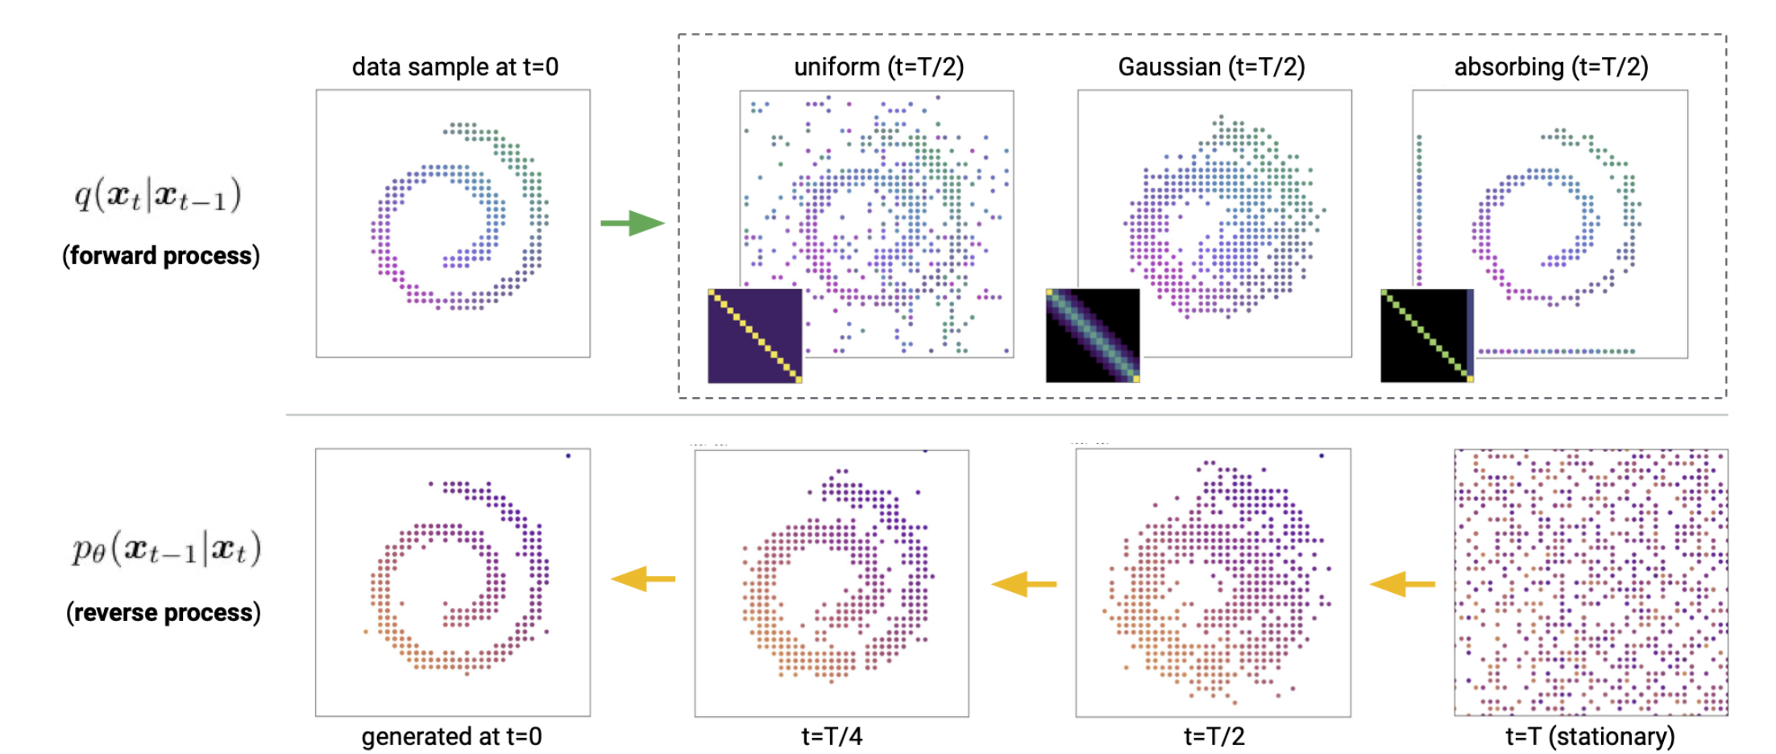
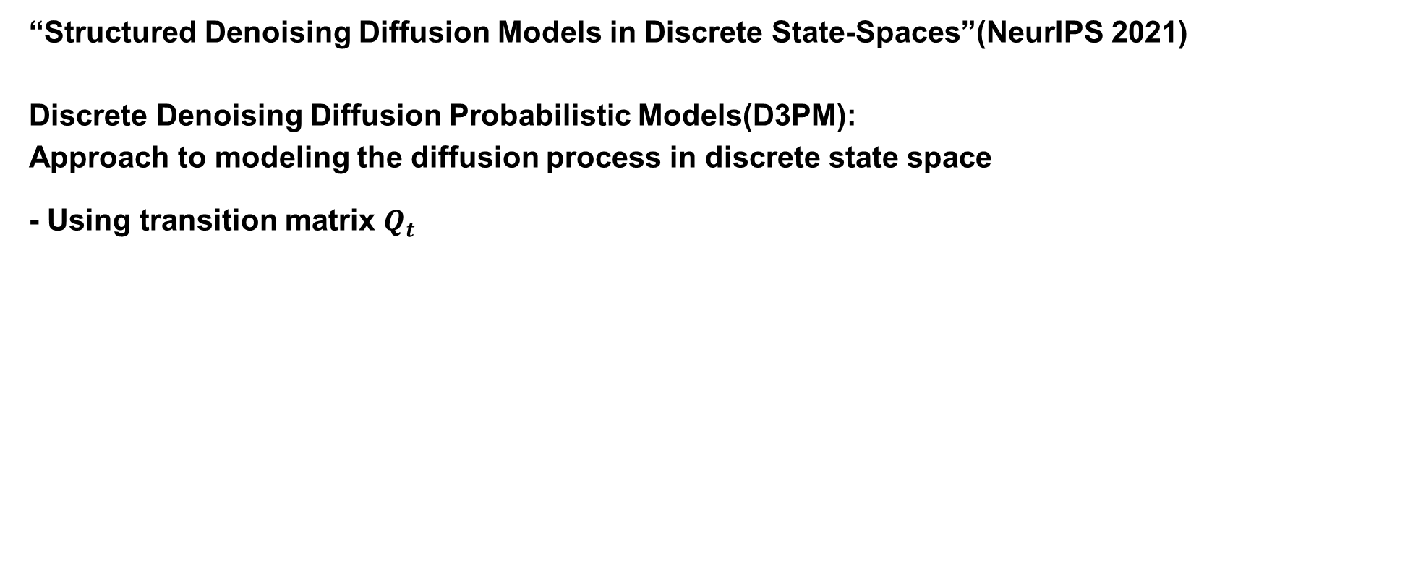
D3PM
“Structured Denoising Diffusion Models in Discrete State-Spaces”(NeurIPS 2021)
Discrete Denoising Diffusion Probabilistic Models(D3PM):
Approach to modeling the diffusion process in discrete state space
- Using transition matrix $Q_{t}$

Slide 17
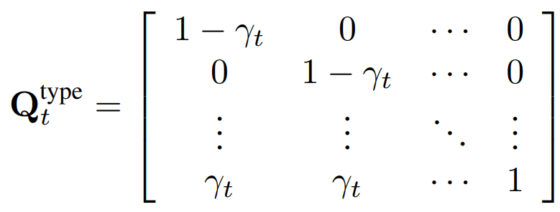
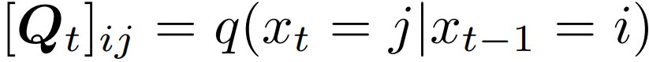
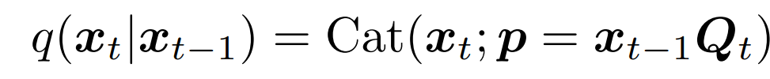
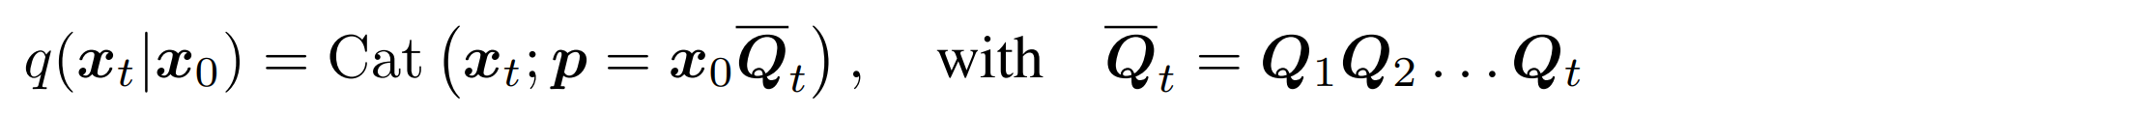
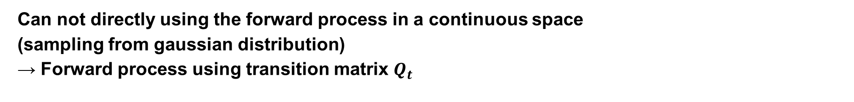
Forward process of D3PM
Can not directly using the forward process in a continuous space
(sampling from gaussian distribution)
→ Forward process using transition matrix $Q_{t}$
Text
image
mask
Text
image
mask
→ categorical distribution
→ categorical distribution is converge at t =T (e.g. uniform distribution, all masked)

Slide 18
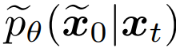
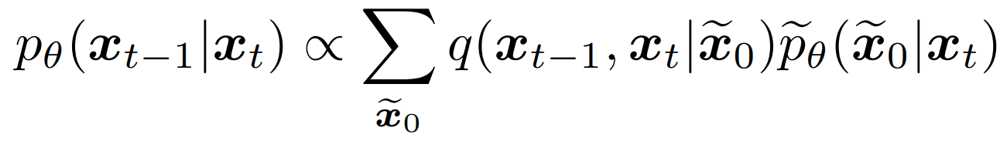
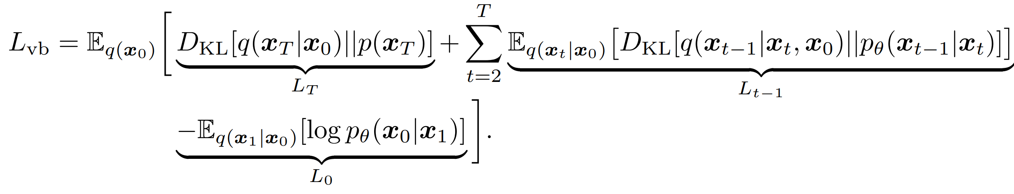
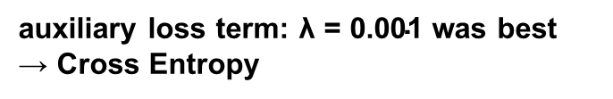
loss of D3PM
Focus on using a neural network to predict the logits of distribution
Loss function:
auxiliary loss term: $\text{λ}\text{ = 0.001}$ was best
→ Cross Entropy

Slide 19
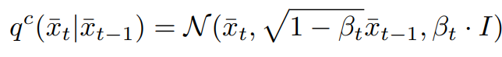
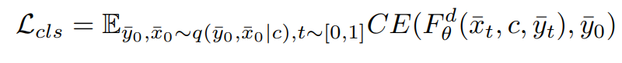
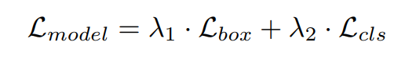
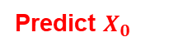
DLT
Joint Discrete-Continuous Diffusion
Position, Size
Type
Continuous diffusion models: DDPM
Discrete diffusion models: D3PM
Predict $X_{0}$
keeping or masking
(absorbing-state)
Continuous loss:
Discrete loss:
D3PM
Reweighted absorbing-state
D3PM objective

Slide 20
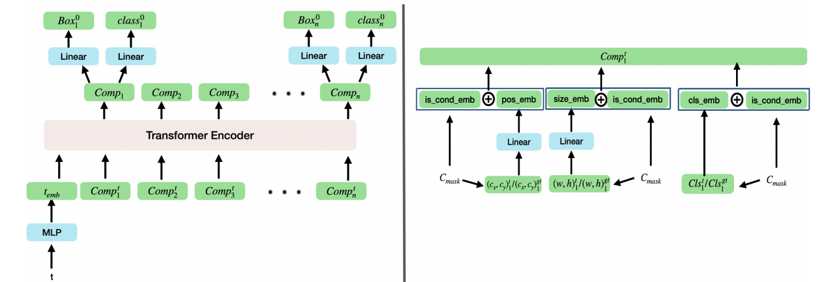
Model Architecture
Condition binary mask
Input: {(type, C), (position, C), (size, C)}… ※ C: condition (true or unknown)
output: {type, position, size}…

Slide 21
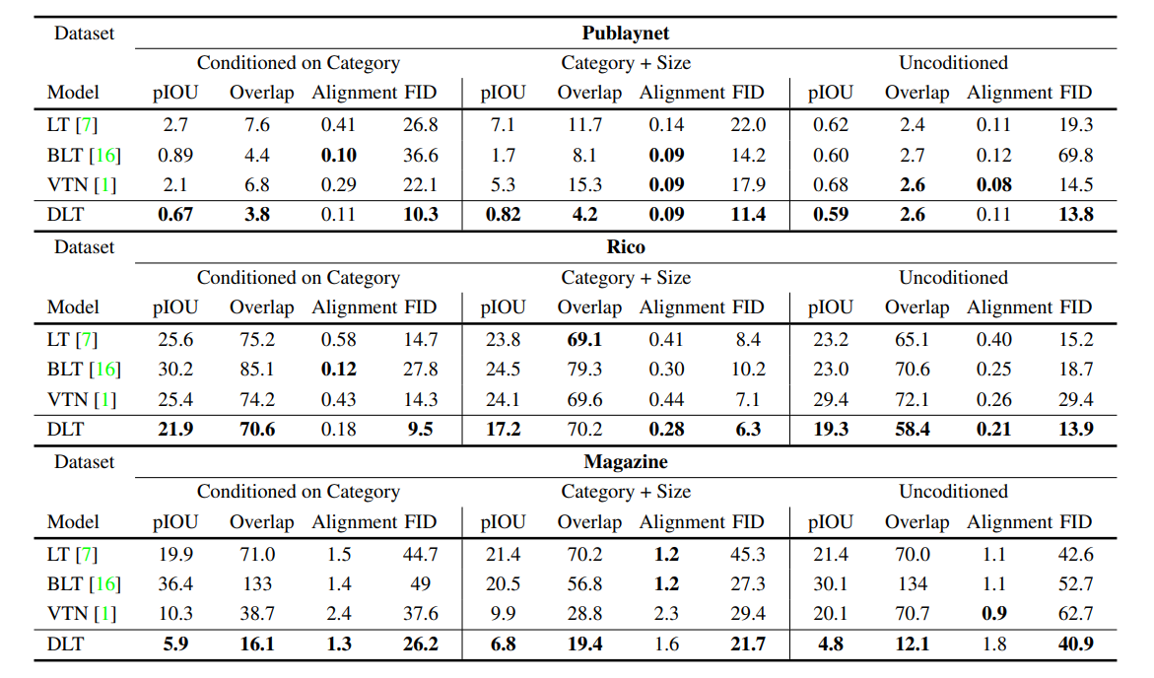
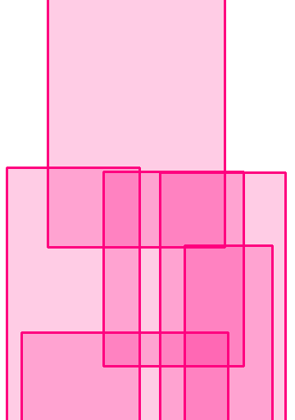
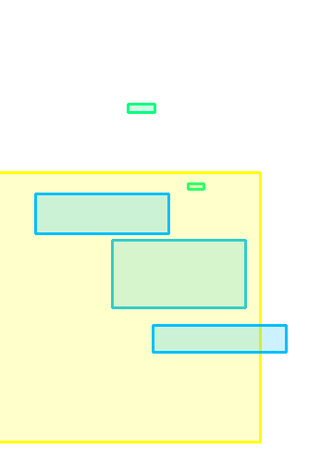
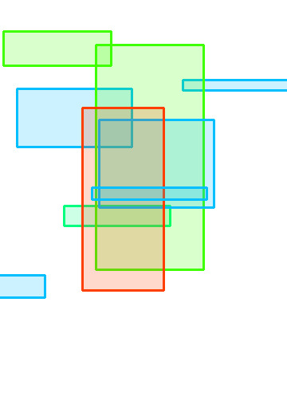
Experiments

Slide 22
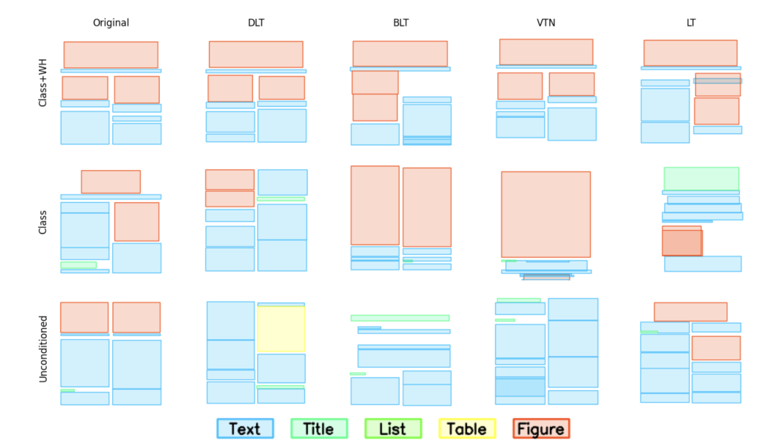
Experiments

Slide 23
Conclusion
Contribution
- apply Joint Discrete-Continuous Diffusion to layout generation
Limitation
- Utility↓: model does not generate layout by looking at each contents, the suitable contents must be manually inserted by a person

Slide 24
Our model
Update
Text
512
Overfitting
512
6
Type
MLP
(x, y, h, w, r, z)
Ratio
Concat
MLP
Image
MLP
Transformer Layer
Predicted Geometry
Geometry
(x, y, h, w, r, z)
MLP
MLP
Time step

